Slide 1

CLUSTER LEVEL SCIENCE EXHIBITION 2017-18 INFORMATION TECHNOLOGY C++ PROGRAM OF CALENDAR
GUIDED BY:- DESIGNED BY:-
Mr. G.N.SAIN Ma. DEVANSH VERMA
Mr. AHMED ALI KHAN Ma. KRISHNAKANT
Ma. ANKIT PATIDAR
Ms. RANJEETA DHAKAD

Slide 2
INTRODUCTION
Nowadays in the era of digitalisation, everyone is aware of computing technology but only a few knows how it works and its basic implementation
C++ one of the highly used programming language.
Microsoft, Intel, IBM etc.
Major Implementation: C++LLVM Clang,GCC,Microsoft Visual C++,Embarcadero C++ Builder, intel C++ Compiler,IBM XL C++
This is a basic program to calculate the day on any date of any month and year. The source code is developed in C++.

Slide 3
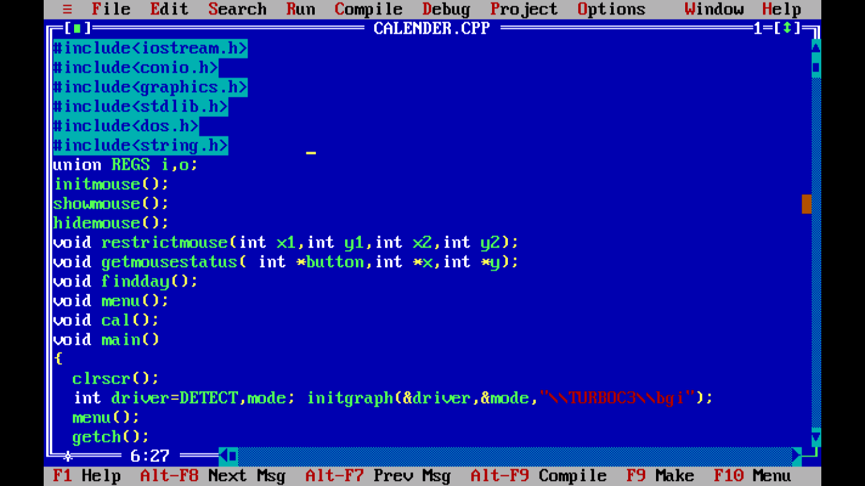
OVERVIEW

Slide 4
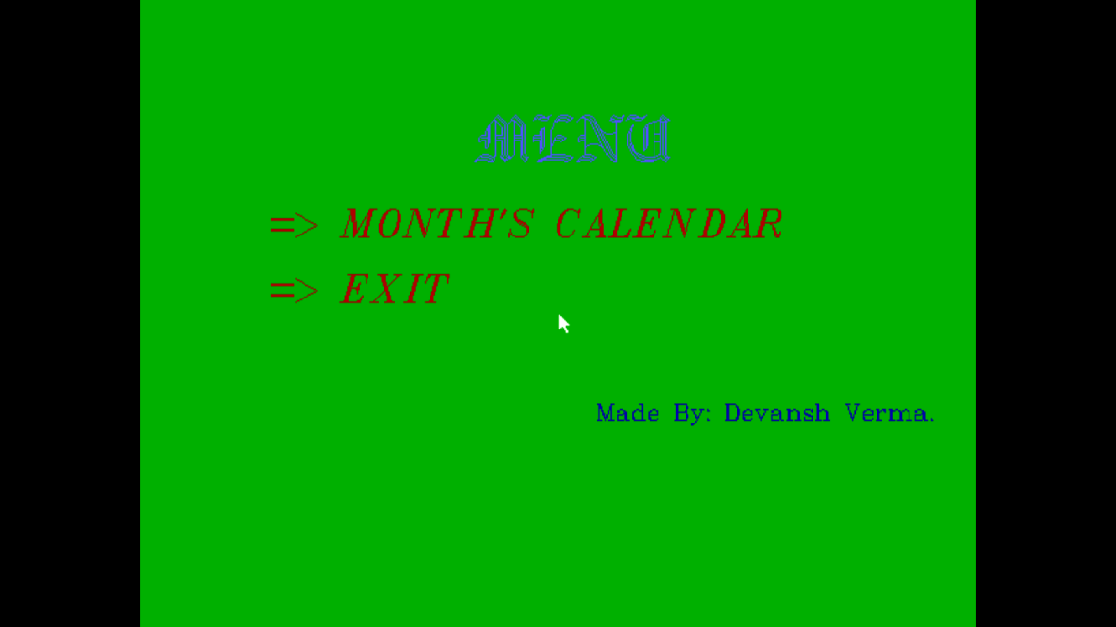
RUN THE PROGRAM AND CLICK ON FIRST OPTION

Slide 5
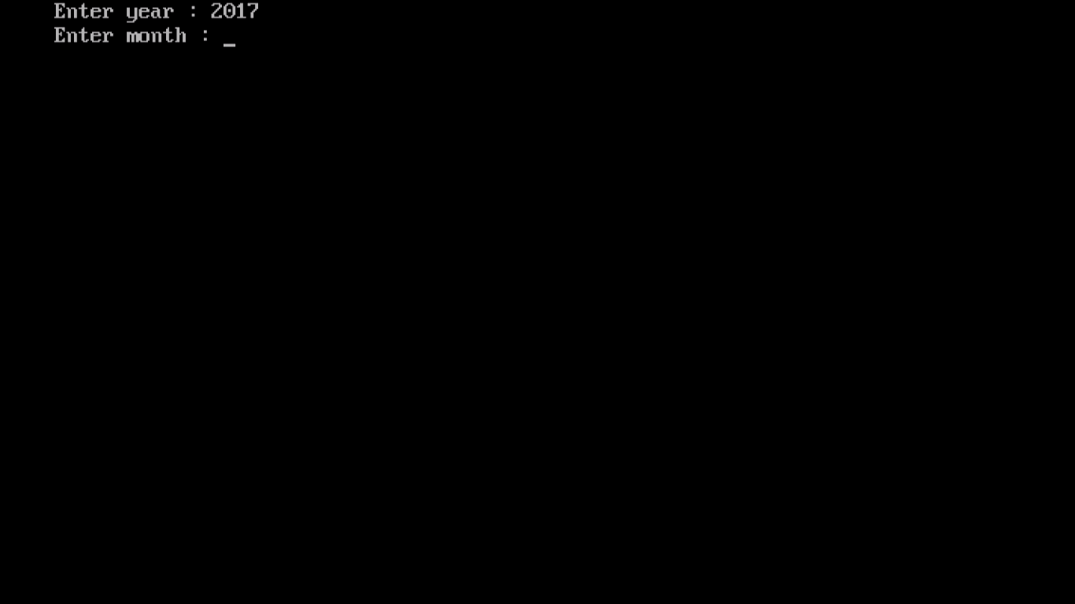
NOW ENTER THE YEAR YOU WISH

Slide 6

ENTER THE MONTH

Slide 7
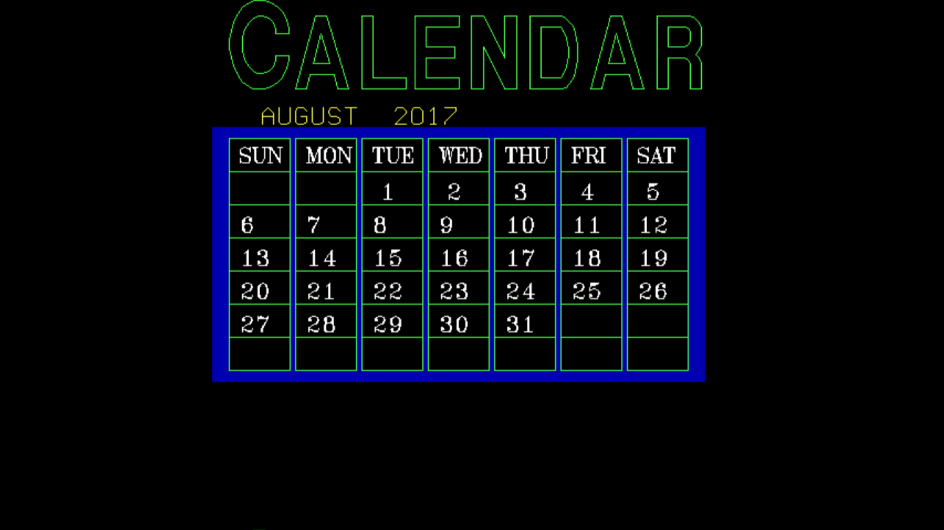
THE SCREEN WILL DISPLAY THE CALENDAR OF THE MONTH YOU REQUESTED

Slide 8

PRESS BACKSPACE AND THEN CLICK ON EXIT

Slide 9
ACKNOWLEDGEMENT
This project was supported/partially supported by Principal of my JNV . We thank our colleagues from class eleventh who provided insight and expertise that greatly assisted the research, although they may not agree with all of the interpretations/conclusions of this paper.
We thank Mr. Govind Sain for assistance with methodology of programming, and Mr. Ahmed Ali khan for comments that greatly improved the program.
We would also like to show our gratitude to Ma. Krishna Kant Vishwakarma for sharing their pearls of wisdom with us during the course of this research. We are also immensely grateful to all my class members and seniors for their comments on an earlier version of the manuscript, although any errors are our own and should not tarnish the reputations of these esteemed persons.

Slide 10
REFRENCES
C++ book of class 11 and 12 by Mrs. Sumita Arora.
Turbo C/C++ by Mr. Herbert Schildt
Object-Oriented Programming
in Turbo C++ by Mr. Robert Lafore
Internet

Slide 11
THANK
YOU

